Slide 1
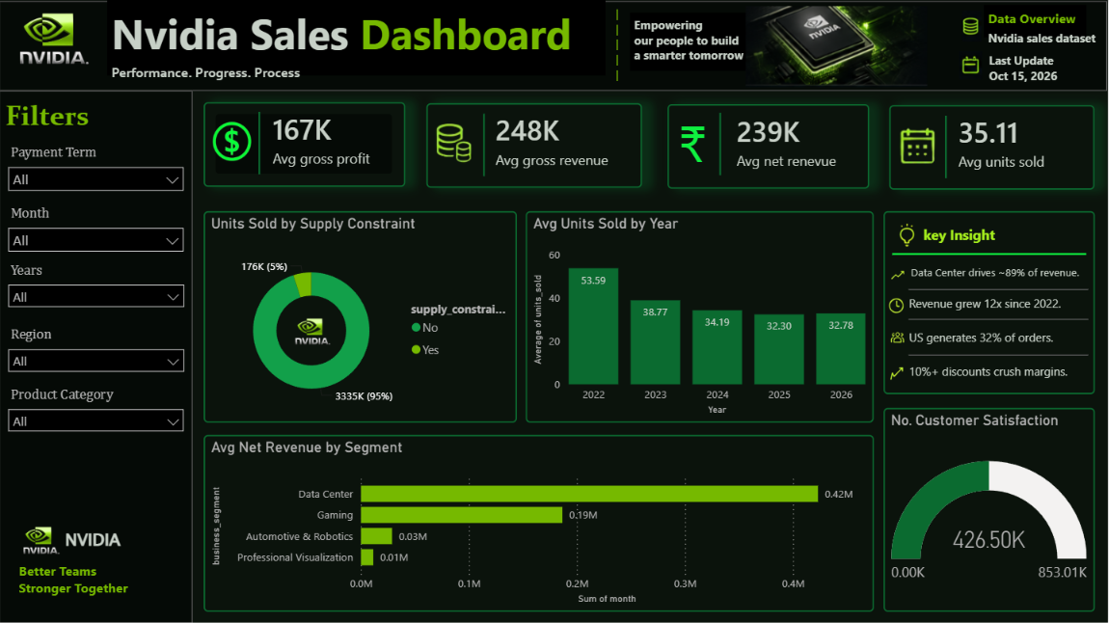
POWER BI DATA VISUALIZATION PROJECT
Nvidia Sales
Dashboard
Performance. Progress. Process.
Prepared by Teli Sujal Sitaram

Slide 2



Project Overview
Objective
Analyse Nvidia sales performance across products, regions and payment terms to support better business decisions.
167K
248K
Avg Gross Profit
Avg Gross Revenue
Dataset & Tool
Nvidia sales dataset visualised in Microsoft Power BI, last updated on Oct 15, 2026.
239K
35.11
Interactive Filters
Payment Term, Month, Year, Region and Product Category slicers let users drill into the data.
Avg Net Revenue
Avg Units Sold

Slide 3
Dashboard Overview
Key Insights
Data Center drives ~89% of revenue
Revenue grew 12x since 2022
US generates 32% of orders
10%+ discounts crush margins
95% of units sold with no supply constraint
Main dashboard built in Power BI

Slide 4
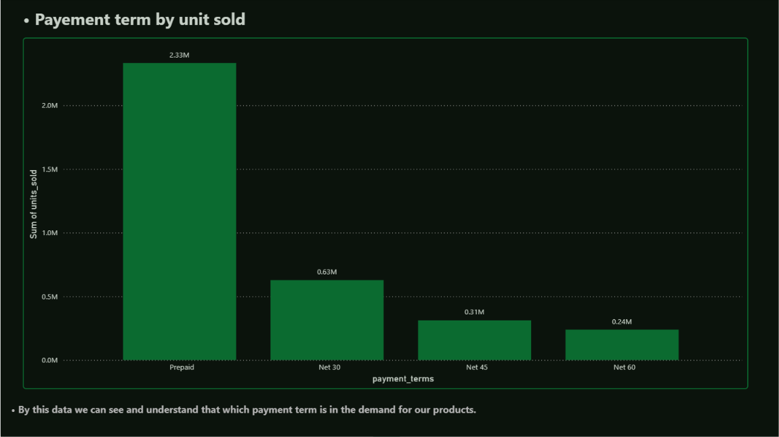
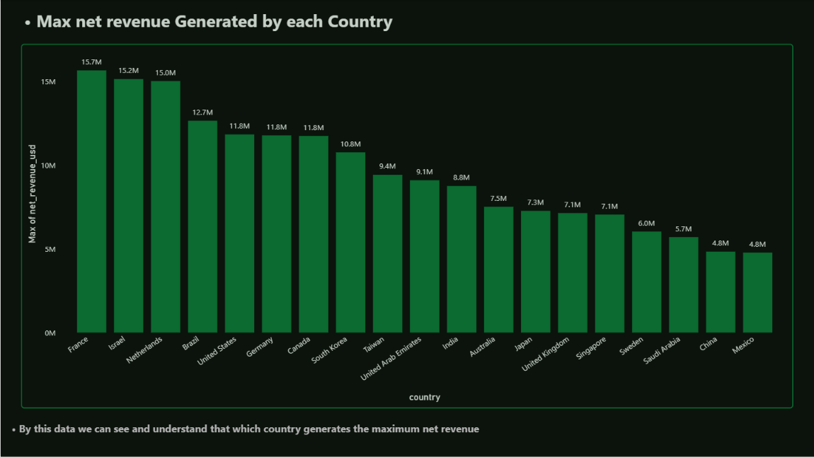
Payment Terms & Country Performance
Units Sold by Payment Term
Max Net Revenue by Country
Prepaid leads with 2.33M units, well ahead of Net 30 (0.63M), Net 45 (0.31M) and Net 60 (0.24M). Customers clearly prefer paying upfront.
France (15.7M), Israel (15.2M) and Netherlands (15.0M) record the highest net revenue, while China and Mexico are lowest at 4.8M each.

Slide 5
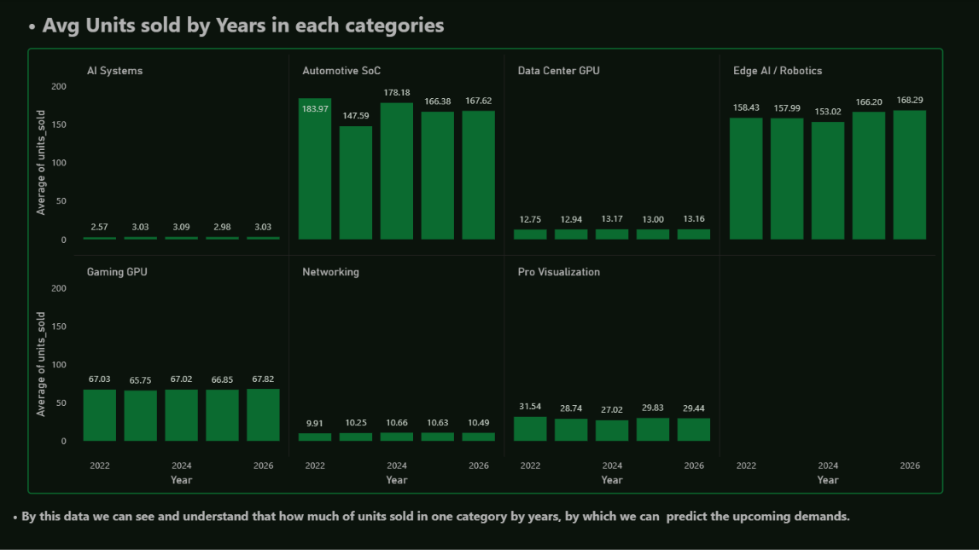
Category Demand Trend (2022-2026)
What the trend shows
Automotive SoC and Edge AI lead with roughly 150-185 average units
Gaming GPU stays steady at about 67 units
Pro Visualization eased from 31.5 (2022) to 29.4 (2026)
Data Center GPU, Networking and AI Systems are low-volume and flat
Stable yearly patterns help predict upcoming demand.
Average units sold by year in each category

Slide 6




Conclusion & Key Takeaways
Data Center leads
Prepaid is preferred
Data Center contributes ~89% of revenue, with revenue up 12x since 2022.
Prepaid orders dominate unit sales (2.33M), far above any credit term.
Strong global reach
Protect margins
The US generates 32% of orders; France, Israel and Netherlands lead on peak net revenue.
Discounts above 10% hurt margins, while 95% of units sell with no supply constraint.
Overall, the dashboard turns raw sales data into clear, actionable insights on products, regions and pricing.

